Slide 1





Predictive Model for Movie Revenue Estimation and Decision Support
By:
Anand Raj
Dinesh Anand Thulasiraman
Kanishk Goel
Siyu Du

Slide 2
Introduction
Dynamic Cinematic Landscape
Genre Variety
Engaging Viewer Imagination
Dataset Exploration Kickoff

Slide 3
Introduction to Dataset
Comprehensive Cinematic Insight
Film Details
Key Financial Metrics
Financial Dynamics
Highlighted
Genre Diversity
Unveiling Film Dynamics
Column Names | Description | Data Type
Revenue | Earnings | Numeric
Popularity | Popularity Index | Numeric
Avg_Vote | Viewer Ratings | Numeric
Vote_Count | Number of Votes | Numeric
Trailer_Views | Trailer Views Count | Numeric
Trailer_Likes | Trailer Likes Count | Numeric
Budget | Production Budget | Numeric

Slide 4
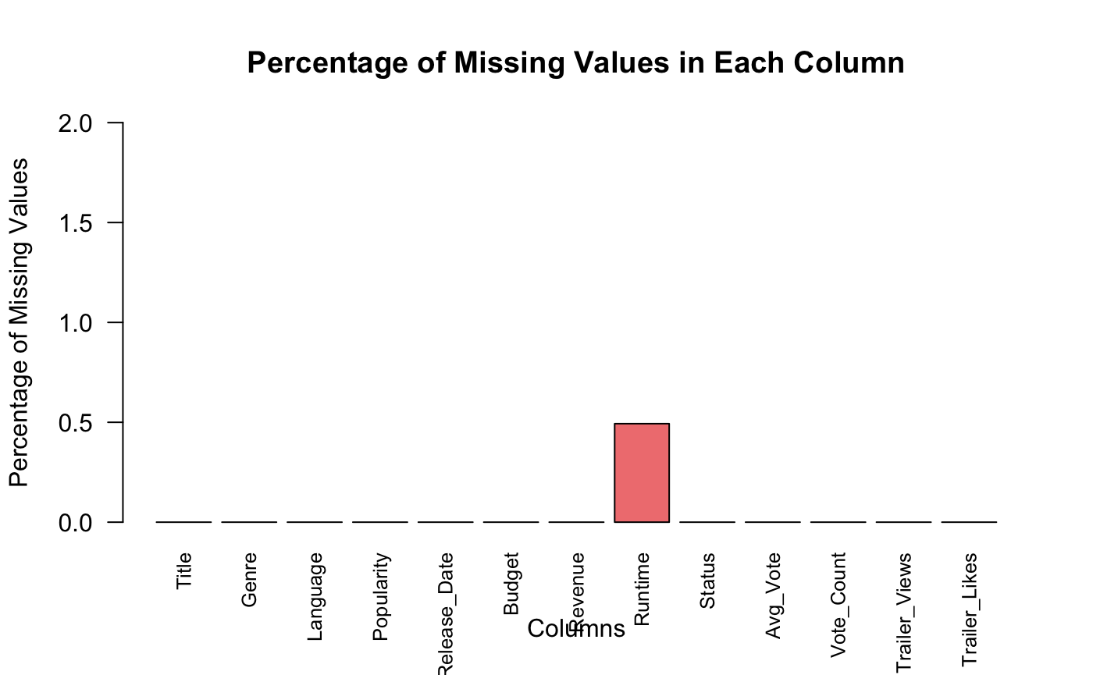
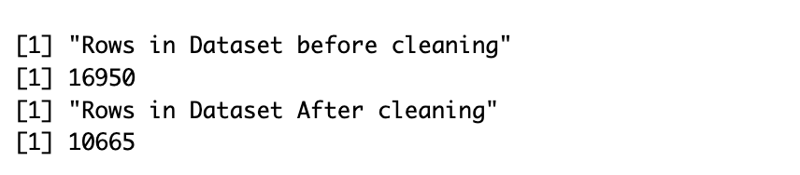
Missing Values & Data Cleaning

Slide 5
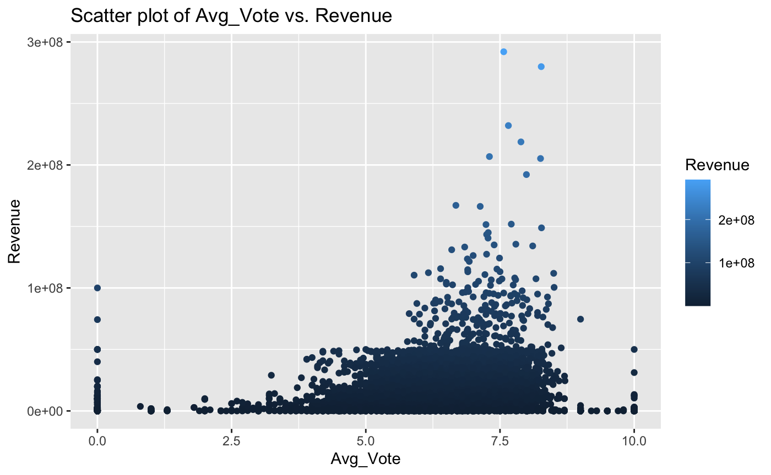
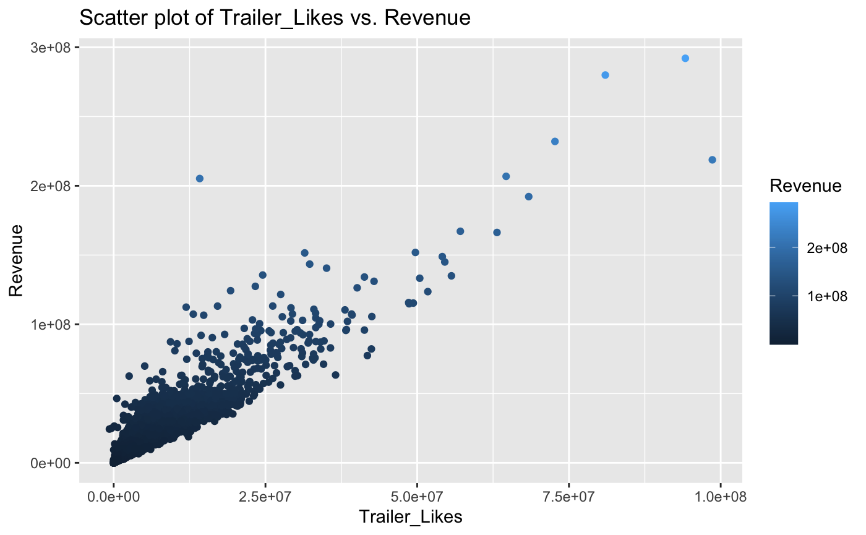
Scatterplots

Slide 6
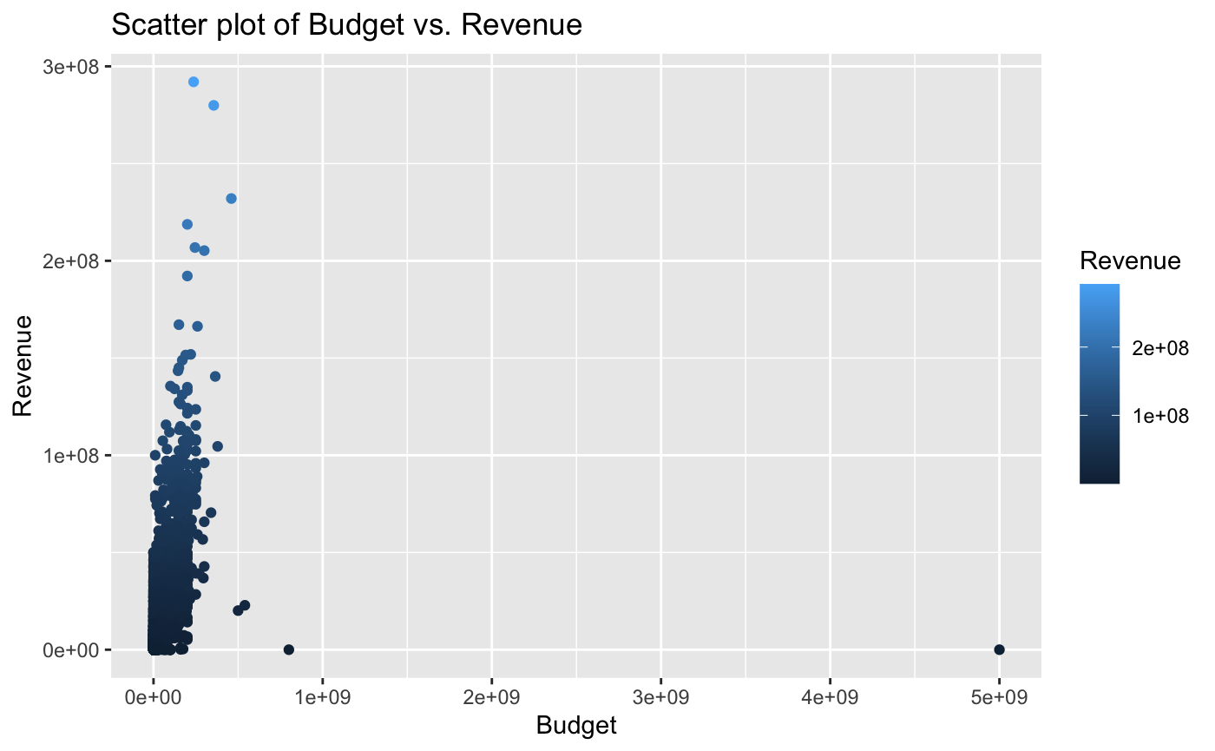
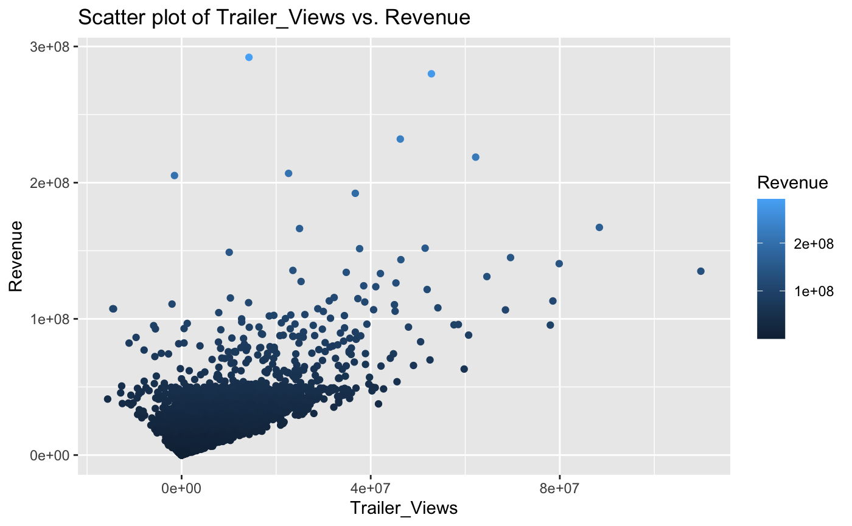
Scatterplots

Slide 7
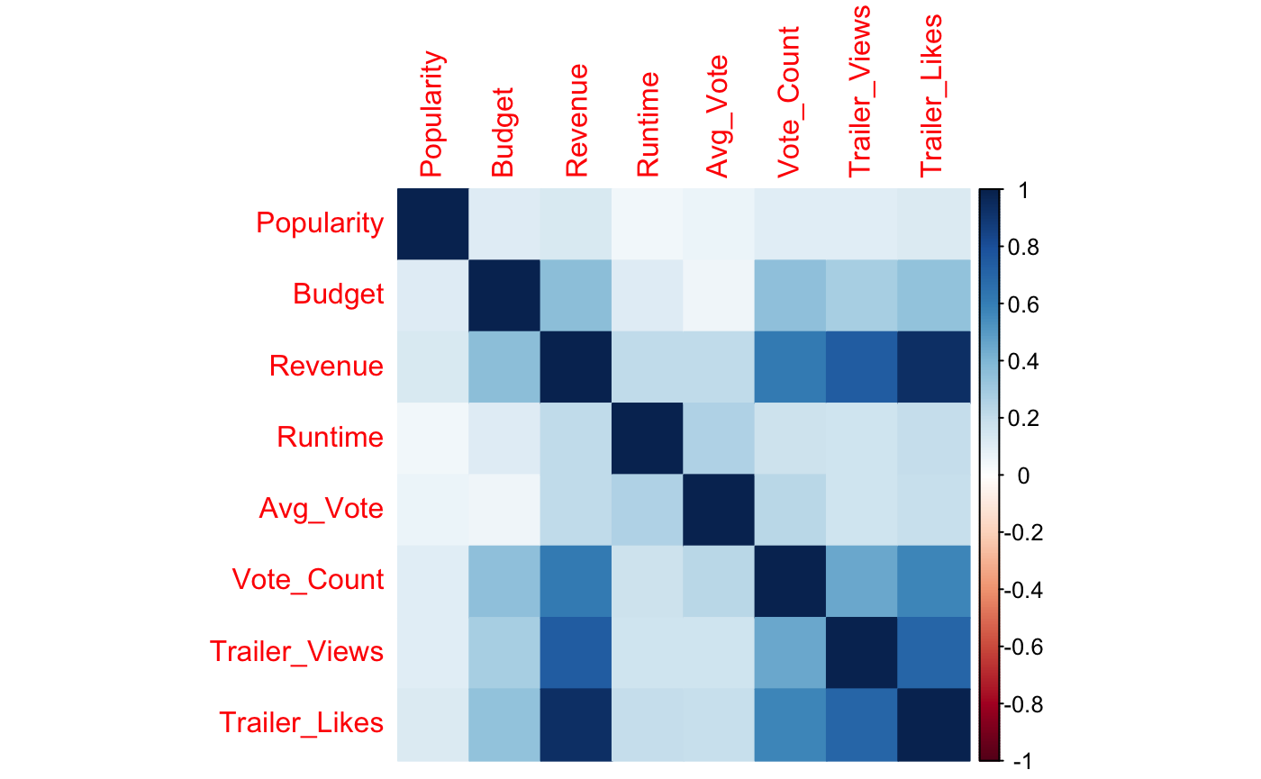
Heatmap

Slide 8
Smart Questions
Can you identify which genres of movies tend to generate the highest revenue?
What is the average revenue generated by movies with a specific budget range?
Can you develop a model that can accurately predict the revenue of a movie based on its features, such as director, and genre?
How can we use revenue prediction models to inform movie production decisions?

Slide 9
Conclusion

Slide 10
Thanks!

